Slide 1



Virtual Asset Custody System
Secure and Efficient Digital Asset Management
Hong Kong Gifpay Technology

Slide 2

Contents
I. Industry Development Status
II. Customer Pain Points
III. Product Introduction
IV. Success Stories
V. Application Scenarios

Slide 3





Industry Development Status
Market Size
Growth Drivers
In 2024, the global cryptocurrency custody market size reached USD 4.85 billion, and is expected to grow at a CAGR of 19.38% through 2032.
Custody demand for stablecoins is surging; institutional investors (e.g., hedge funds, pensions, family offices) are driving compliant custody needs.
Development Trends
RWA (Real-World Assets) tokenization, such as on-chain treasuries and real estate, increases custody demand.

Slide 4
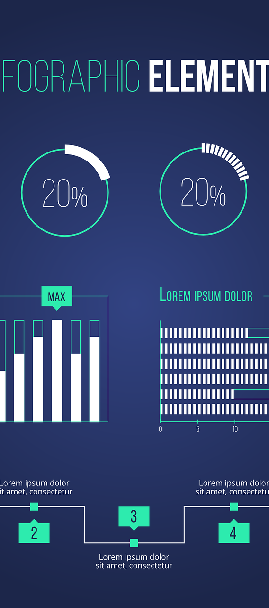

Industry Compliance and Security Trends
Global Regulatory Frameworks Accelerating Implementation
Licensing and Certifications as Industry Thresholds
EU MiCA: requires stablecoin issuers to use qualified custodians and implement strict asset segregation;
US SEC new rules: expand custody scope to all crypto assets, pushing institutions to adopt compliant custody solutions;
Asia-Pacific: Hong Kong and Singapore issue custody licenses, requiring custodians to operate under license
Mandatory licensing: major jurisdictions require custodians to obtain specific licenses (e.g., New York trust license, Hong Kong VASP, TCSP licenses);
International certifications: SOC 2 Type II and ISO 27001 become baseline requirements; some institutions must comply with GDPR (EU data protection).
Anti-money Laundering (AML) Upgrades
On-chain monitoring tools widespread: solutions like Chainalysis and Elliptic are integrated into custody systems to track fund flows in real time;
Travel Rule compliance: transactions over USD 1,000 must share sender/receiver information (FATF standard).

Slide 5
Contents
I. Industry Development Status
II. Customer Pain Points
III. Product Introduction
IV. Success Stories
V. Application Scenarios

Slide 6
Primary Pain Points for Users/Institutions
Security Risks
Compliance and Regulatory Challenges
Liquidity Management Issues
Private key management challenges: institutions face risks of key loss, insider malfeasance, and hacking; individual users struggle to manage seed phrases;
Smart contract vulnerabilities: DeFi custody solutions (e.g., multisig wallets) still carry code vulnerability risks;
Physical security threats: cold storage devices may be subject to physical theft or damage from natural disasters.
Fragmented licensing: differing licensing requirements across countries (US, EU, Asia) force institutions to obtain multi-jurisdictional approvals at high cost;
KYT/AML pressure: institutions must conduct stringent on-chain transaction monitoring.
Low efficiency in cross-chain asset custody: institutions holding multi-chain assets such as BTC, ETH, SOL must use different custody solutions, resulting in low efficiency in fund allocation;
Insufficient DeFi integration: traditional custodians do not support DeFi protocols, preventing institutions from directly engaging in staking, lending, and other yield strategies.

Slide 7
Contents
I. Industry Development Status
II. Customer Pain Points
III. Product Introduction
IV. Success Stories
V. Application Scenarios

Slide 8
Custody Platform Technical Architecture
Application Layer
Zone 1 applications
Zone 2 applications
Zone 3 applications
Zone N applications
API Interface
API Interface
API Interface
Custody System
Zone 1
Zone 2
Zone 3
Cryptographic module
KYA/KYT interfaces
Platform Portal
Outbound
Inbound
External Wallets
Web3 Wallet1
Web3 Wallet2
Web3 Wallet3
Web3 Wallet4
Web3 Wallet5

Slide 9

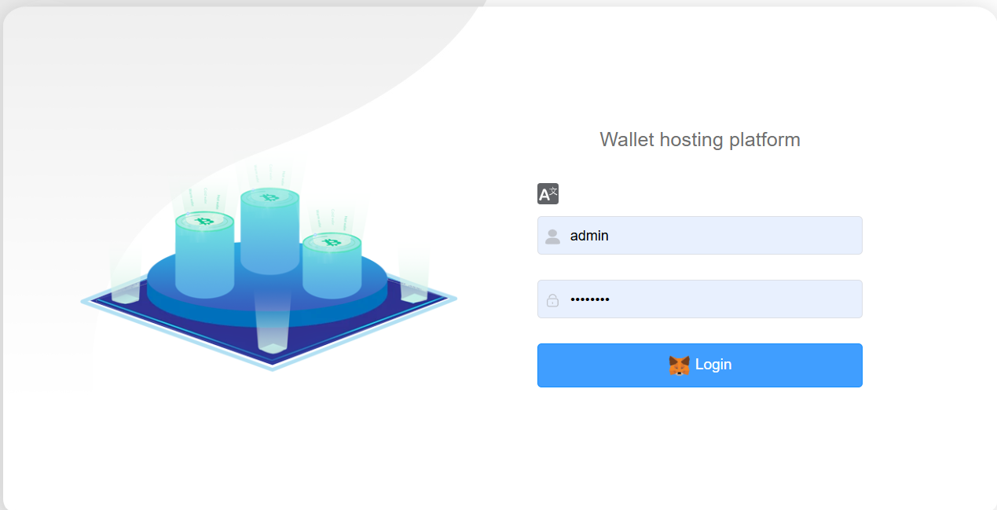


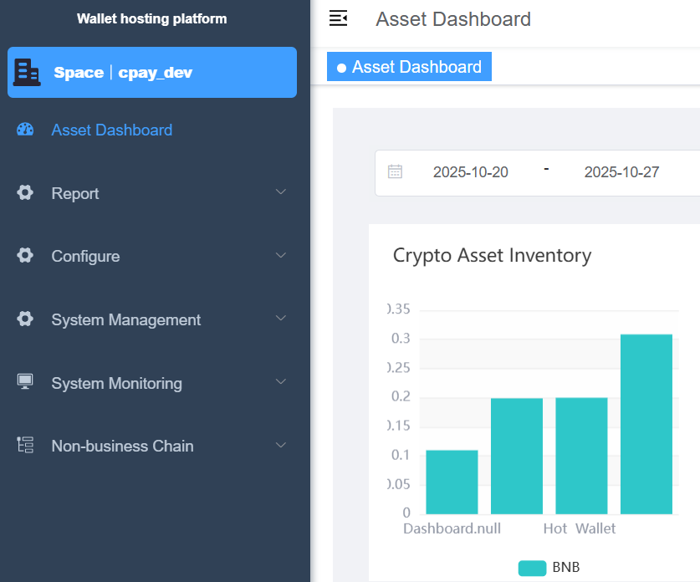
Custody Platform Portal
Positioning
Operations and management portal for partners.
Core Functions
Customer zone management
Crypto asset dashboard (asset inquiry);
Customer transaction inquiry
System management and monitoring.

Slide 10
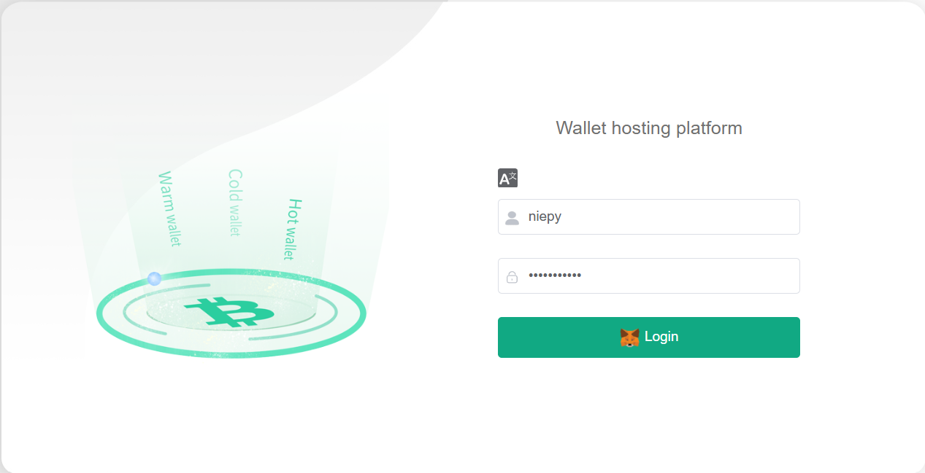
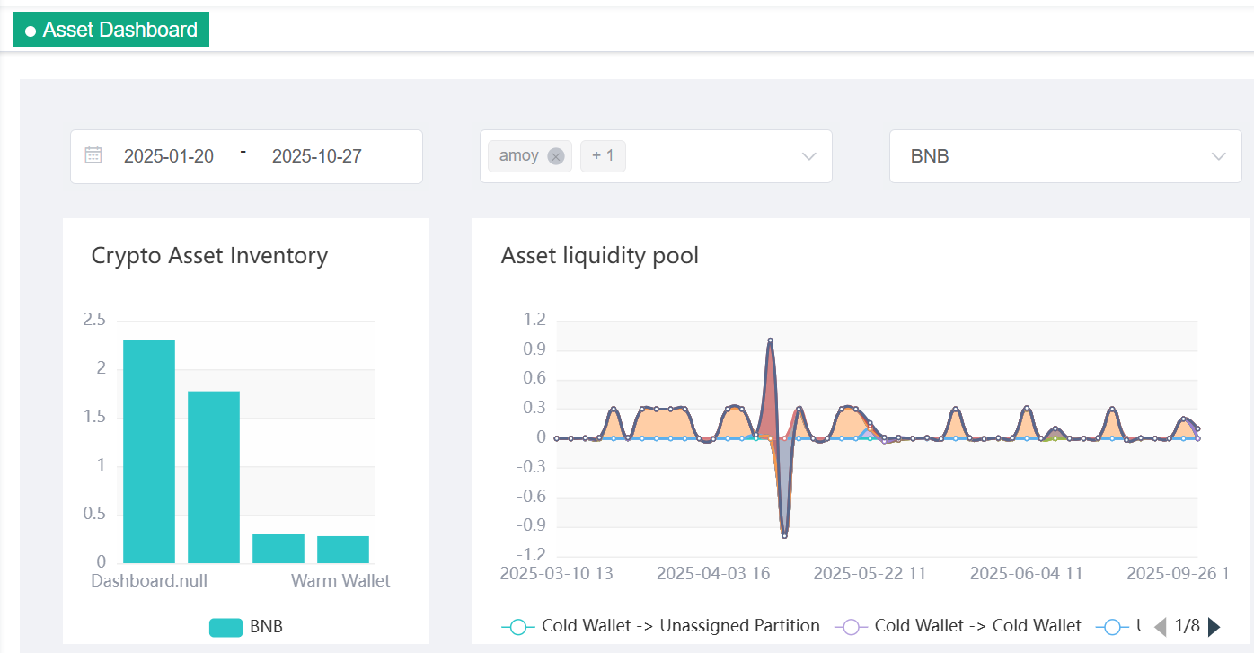
Custody Zone Portal
Positioning
Operations and management portal for partner clients.
Core Functions
Parameter configuration (chains, token types; Admin/operator/maker and checker roles and permissions configuration);
Position management (position monitoring, position allocation);
Asset inquiry (crypto asset dashboard);
Transaction inquiry and accounting management (on-chain and off-chain reconciliation).

Slide 11

Three-tier Wallet Architecture: Hot/Warm/Cold Wallets
Zone-isolated wallet management: warm and hot wallets are isolated between zones; different zones are assigned different cold wallets to prevent fund commingling across zones. Each zone can have distinct parameters for fund consolidation, transfer limits, non-whitelist handling, etc. Zones may adopt different management approaches, and even different private key storage methods to meet compliance requirements in different regions
对比项B
Hot Wallet
Warm Wallet
Continuously connected digital asset storage; private keys stored online, providing instant transaction capability.
Suitable for small, high-frequency daily transactions, prioritizing
convenience.
Online storage solution that balances security and convenience through multisig or delayed transaction mechanisms.
Suitable for institutional or team mid-to-high-frequency, medium-amount management, balancing security and efficiency.
Cold Wallet
Fully offline storage system; private keys never touch the network.
Suitable for large, long-term storage, prioritizing security.

Slide 12




Crypto Asset Custody Platform
The crypto asset custody platform is one of the core systems of digital finance. It integrates KYA (Know Your Address) and KYT (Know Your Transaction) and provides flexible API interfaces. Main functions:
Centralized Custody of Crypto Wallets
KYA and KYT
Provide centralized custody services for crypto wallets to ensure client crypto asset security; support cold, warm, and hot wallet types to meet diverse secure operations and compliant storage requirements.
Support management and verification of crypto wallet addresses to ensure address security and legality; support real-time
monitoring of suspicious transaction activities to ensure all transactions comply with AML and CFT requirements.
Efficient Security Management and Monitoring
API and Third-party System Integration
Built-in advanced cryptographic security to protect the storage and transfer of entrusted crypto assets; real-time monitoring and alerts to promptly identify and respond to potential threats, ensuring custody wallet security and reliability
API interfaces support comprehensive, seamless integration with third-party systems. Flexible and scalable API calls help clients and partners integrate custody platform capabilities into their existing applications
Audit and Compliance Support
Support comprehensive audit of transaction records; operations and transactions are traceable, ensuring compliance and transparency; provide compliance reports aligned with international and local regulatory requirements to help clients meet legal and regulatory standards across jurisdictions

Slide 13

Core Features
Regulatory-compliant Cold Wallet Storage and Management
Multi-KYT/KYA Provider Support
Support integration with multiple KYT and KYA providers, offering flexible compliance service options to suit diverse compliance requirements and market needs.
Support regulatory requirements for cold wallet storage, ensuring secure offline storage of crypto assets; integrated KYT and KYA functions ensure transaction and address security and legality.
Support for Multiple Key Management Methods
Multi-zone Management and Isolation of Crypto Assets
Support multi-zone management of crypto assets to achieve independent management and risk isolation; each zone can be customized according to client needs to ensure secure,
independent operation across zones.
Support multiple wallet key management methods, including Hardware Security Modules (HSM) and Multi-Party Computation (MPC) wallets, ensuring secure and flexible key management to meet diverse client needs.

Slide 14

Supported Public Chains and Asset Categories
List of Supported Mainstream Public Chains
Supported Token Protocol Types
Ethereum/Polygon/BSC/Tron/Avalanche/
Fantom/Converge/Monad/Scroll/ThunderCore/
Arbitrum/Astar/Gnosis/Linea/Optimism/Starknet
ERC-20\TRC-20\BEP-20
Scalability and New Token/Chain Adaptation Capability
Seamless expansion to EVM-type chains

Slide 15

Crypto Asset Custody Platform API Capabilities
Invocation Interfaces
Notification Interfaces
Create customer wallet address
Customer wallet withdrawal
Create customer wallet whitelist
Query customer wallet balance
Query customer wallet transaction details
Customer wallet withdrawal result notification
Customer wallet deposit result notification
Customer wallet address risk notification

Slide 16

Multi-service KYT/KYA Access and Customized Compliance Strategies
Support Mainstream KYT/KYA Providers
Simultaneous Multi-service Access/ Switching
KYT/KYA integrations: goPlus, SlowMist, Beosin.
Each zone can customize which KYT/KYA providers to enable, can enable multiple; each provider has customized KYT/KYA trigger parameters, and can be switched during use.
Risk Interception Strategies
Automated Compliance Tracking and Forensics
Custom compliance scans and custom KYT/KYA interface invocation strategies.
Store KYT/KYA interface logs in the database.

Slide 17

Risk Management and Access Control System
Access Permissions
Multi-factor/Hardware/Biometric Authentication
IP whitelist restrictions;
RSA signature and verification.
Multi-factor login: username and password + MetaMask signature.
Intelligent Risk Control Strategies and Abnormal Alert Mechanisms
Abnormal transaction alerting, transaction review, customer wallet deposit KYT risk control, customer withdrawal limit control, and whitelist restrictions for customer wallet deposits and withdrawals.

Slide 18
Contents
I. Industry Development Status
II. Customer Pain Points
III. Product Introduction
IV. Success Stories
V. Application Scenarios

Slide 19
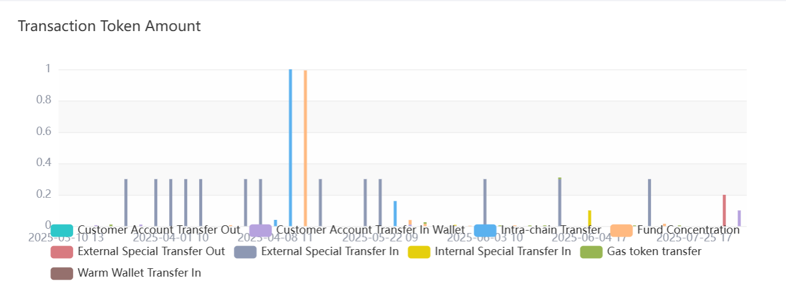
Uniark
Project Background
Established on 28 November 2024, holds a full Polish VASP license, ensuring compliance and security in cryptocurrency and financial services operations.
Project Outcomes
Built a proprietary crypto asset custody platform based on Thales Luna HSM, providing secure and reliable asset custody services.

Slide 20
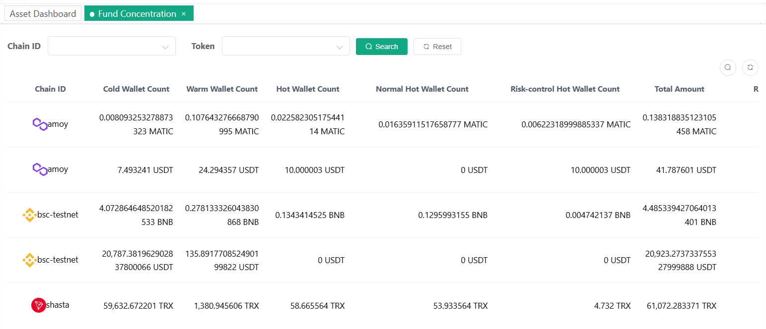
GRDA
Project Background
General Reserve of Digital Assets Limited, abbreviated GRDA, license number: TC004414, is a licensed trust service company authorized and regulated in Hong Kong since 2018.
Project Outcomes
Supports custody of multiple currencies including USD, EUR, HKD, USDC, and USDT; built a proprietary custody platform using Thales Luna HSM to ensure asset security.

Slide 21
Contents
I. Industry Development Status
II. Customer Pain Points
III. Product Introduction
IV. Success Stories
V. Application Scenarios

Slide 22

Product Application Scenarios
Crypto-native Enterprises
Institutional Investors
Exchanges (user asset custody), lending platforms (collateral security management), staking service providers (validator key management), DeFi protocols (treasury multisig management), etc.
Hedge funds, family offices, endowments, pension funds, and asset managers that hold substantial capital and require professional crypto custody systems to safeguard assets.
Financial Institutions
Government and Public Sector
Banks and fintech companies in traditional finance are entering the space and need crypto custody systems to provide digital asset storage services to clients, or to manage their own crypto investments.
Central bank digital currency (CBDC pilot custody), sovereign wealth funds (sovereign crypto asset allocation) / university endowments (e.g., Yale allocating crypto assets).
Enterprise Clients
High-net-worth Individuals
Public companies (e.g., Tesla and other listed firms holding BTC, corporate treasury digital asset allocation).
Individuals holding substantial crypto assets who demand security and professional management, seeking to leverage custody systems for asset protection and obtain professional allocation advice and related services.

Slide 23

Thank You for Watching
Contact us:
marketing@gifpay.com
Hong Kong Gifpay Technology

